Slide 1


Slide 2
l
fMG' BIG BAlbl ,,
-.
I
-
I
1 / ,_
I
.._
- - · -"'
. •'• • I: ,- . .- '
' I!.

Slide 3
You need to calculate the monthly sales of the store and identify which month had the highest sales and which month had the lowest sales.
You need to analyze sales based on product categories and determine which category has the lowest sales and which category has the highest sales.
3. The sales analysis needs to be done based on sub-categories
You need to analyze the monthly profit from sales and determine which month had the highest profit.
Analyze the profit by category and sub-category.
6. Analyze the sales and profit by customer segment
7. Analyze the sales to profit ratio

Slide 4


fig = px .line sales_by_month,
x= 'Order Month ', y= 'Sales ',
title= 'Monthly Sales Analysis')
fig.show()
Monthly Sales Analysis
300k
"v'
V"l'
200k
1OOk
2
4
6
Order Month
8
10
12

Slide 5
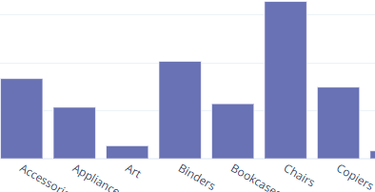
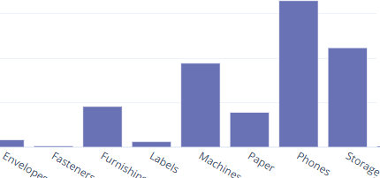

sales_by_subcategory = data .groupby('Sub-Category')['Sales'].sum ().reset_index() fig = px.bar(sales_by_subcategory,
x= 'Sub-Ca tegory•,
y= 'Sales' ,
title= 'Sales Analysis by Sub-Category')
fig.show()
Sales Analys is by Sub-Category
300k
l() 200k
1OOk
-
0

Slide 6




sales_profit_by_segment = data.groupby('Se.gment ').agg({'Sales': 'slllrl','Profit': 'sum'}).reset_index() color_palette = colors.qualitative.Pastel
fig = go.Figure()
fig.add_trace(go.Bar x=sales_profit_by_seg«.ent('Se.gment '],
y:sales_profit_by_segnent('Sales'], nafl'.e= 'Sales',
marker_color=color_palette(G]))
fig.add_trace(go.Bar x=sales_profit_by_seg«.ent('Se.gment '],
y:sales_profit_by_segnent('Profit'), nafl'.e= 'Profit', marker_color=color_palette(l]))
fig.update_layout(title= 'Sales and Profit Analysis by Custon:er Segment ', xaxis_title= 'Customer Segment ', yaxis_title= 'Amoont')
fig.show()
Sales and Profit Analysis by Customer Segment
1M
0
Consumer
Corporate
Customer Segment
Home Office

